Slide 1


CREDIT CARD FRAUD DETECTION
Toshani Rungta (PES2UG19CS433) – CSE Dept.
Vismaya iyer (PES2UG19ec163) – ECE Dept.

Slide 2

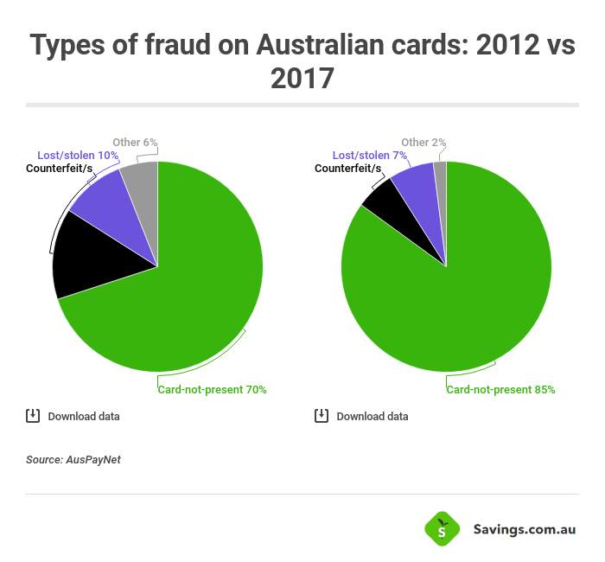
Types of credit card frauds
CNP (Card Not Present) Fraud - If somebody knows the expiry date and account number of your card and uses your card without actually being in physical possession of it
Counterfeit Card Fraud - A fake magnetic swipe card holds all your card details and a fraudulent one is created.
Lost and Stolen Card Fraud - Your card will be taken from your possession, either through theft or because you lost it
Card ID Theft - Details of your card become known to a criminal, and this information is then used to take over a card account or open a new one.
Mail Non-Receipt Card Fraud - Criminal is able to intercept and register the card and they will use it to make purchases and more.

Slide 3

Problem addressed and reason for choosing
MENTIONED PROJECT CHOSEN BECAUSE
An interest in machine learning along with the guidance and mentorship available to understand some core concepts of data analysis and the meaning of various training methodologies as well as their uses in different scenarios
PROBLEM ADDRESSED
The project will be able to classify fraud transactions from the various credit card transactions using logistic regression

Slide 4
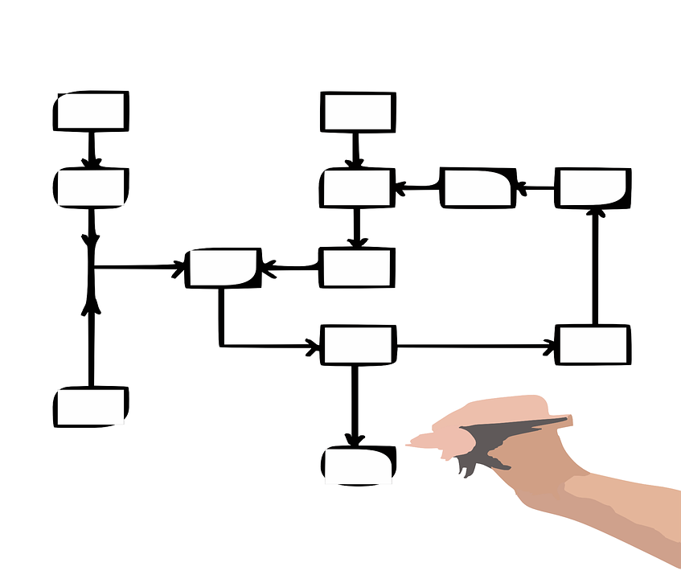
3 broadly classified ml algorithms
Supervised Learning
This algorithm consist of a dependent variable which is to be predicted from a given set of predictors (independent variables). Using the variables, we generate a function that map inputs to desired outputs. The training process continues until the model achieves a desired level of accuracy. Examples : Regression, Decision Tree, Random Forest, KNN, Logistic Regression etc.
Unsupervised Learning
In this algorithm, we do not have any target or outcome variable to predict / estimate. It is used for clustering population in different groups, which is widely used for segmenting customers in different groups for specific intervention. Examples of Unsupervised Learning: Apriori algorithm, K-means.
Reinforcement Learning
Using this algorithm, the machine is trained to make specific decisions. It works this way: the machine is exposed to an environment where it trains itself continually using trial and error. This machine learns from past experience and tries to capture the best possible knowledge to make accurate business decisions. Example of Reinforcement Learning: Markov Decision Process

Slide 5

Methodology
Steps we followed/will perform during the course of the project
Choose the data set
Perform EDA using pandas
Perform Data Visualization using seaborn
Train the model using logistic regression
Test the model
CURRENT STATUS

Slide 6

Choosing the data set
Data Set used: https://www.kaggle.com/isaikumar/creditcardfraud
The datasets contains transactions made by credit cards in September 2013 by European cardholders.
This dataset presents transactions that occurred in two days, where we have 492 frauds out of 284,807 transactions.
It contains only numerical input variables which are the result of a PCA transformation as we cannot provide the original features and more background information about the data due to confidentiality issues.
Number of columns/characteristics: 31
Number of rows/observations: 284807
No NULL/NaN values present, data set taken is already cleaned.
For further information on the data set used, visit: https://www.kaggle.com/mlg-ulb/creditcardfraud/version/3

Slide 7

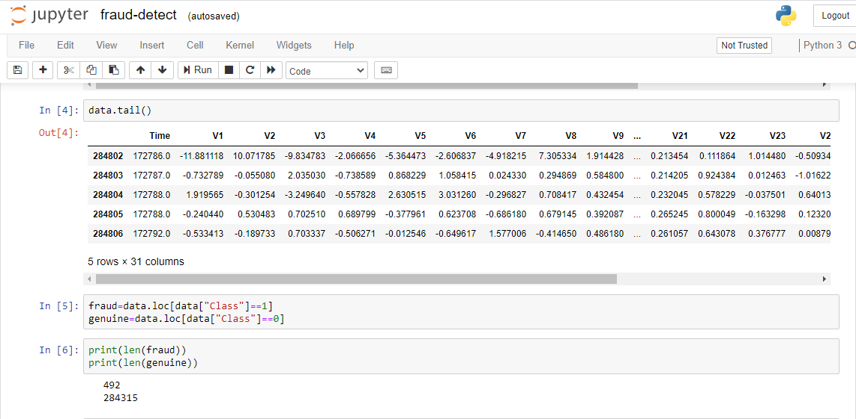
EXPLORATORY DATA ANALYSIS
Performing command to find number of rows, columns, NULL values, total count of each value in a given column etc.

Slide 8
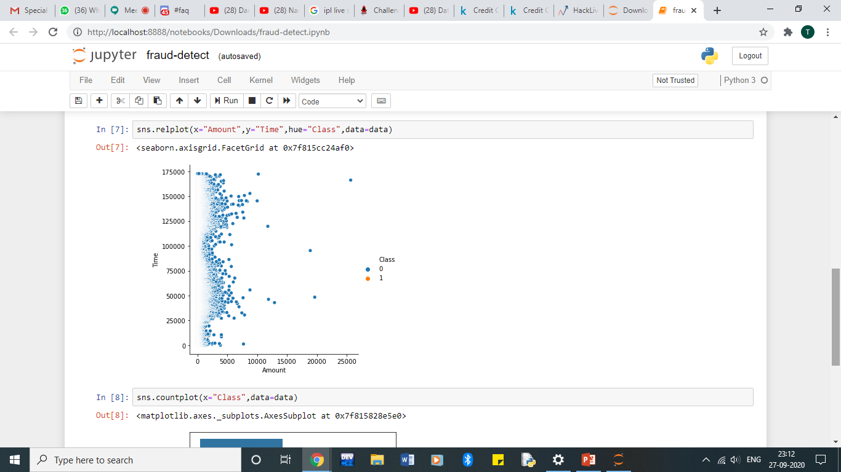
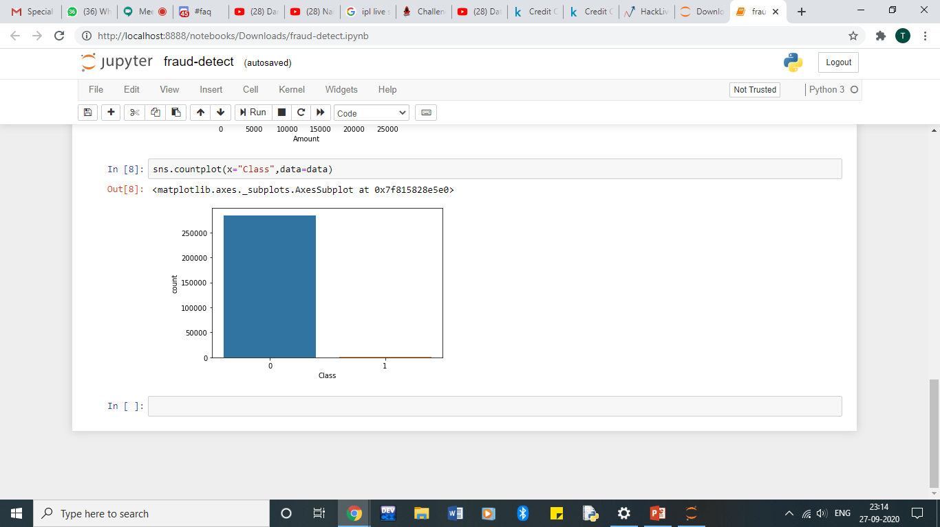
DATA VISUALIZATION
Relational Plot
Count Plot

Slide 9
PROBLEMS FACED WITH THE PROJECT AND ITS SOLUTIONS
?
PROBLEMS
Enormous Data is processed every day and the model build must be fast enough to respond to the scam in time.
Imbalanced Data i.e. most of the transactions (99.8%) are not fraudulent which makes it really hard for detecting the fraudulent ones
Data availability as the data is mostly private.
Misclassified Data can be another major issue, as not every fraudulent transaction is caught and reported.
Adaptive techniques used against the model by the scammers.
SOLUTIONS
The model used must be simple and fast enough to detect the anomaly and classify it as a fraudulent transaction as quickly as possible.
Imbalance can be dealt with by properly using some methods that eliminate overfitting and give more accuracy with available data
For protecting the privacy of the user the dimensionality of the data can be reduced or converted to numeric values without disclosing the criteria in the column name.
A more trustworthy source must be taken which double-check the data, at least for training the model.
We can make the model simple and interpretable so that when the scammer adapts to it with just some tweaks we can have a new model up and running to deploy.

Slide 10
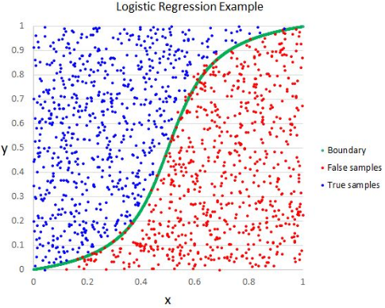
NEXT STEP
Learning Logistic Regression and training the model according to the same.

Slide 11
THANK YOU!

